Slide 1

STUDENT’S INTRANET WEBSITE
PRESIDENCY UNIVERSITY
Web technology mini project
presented by: SARAH RAMZEEN (20241IST0075)
VARUN SWAMY (20241IST0076)
VETRI SELVAN (20241IST0077)
SREELEKHA (20241IST0078)
PAVITHRA (20241IST0079)
Course name: web technology
Course incharge: sunil kumar Sahoo

Slide 2
INTRODUCTION:
The Students’ Intranet Website is a secure web-based platform designed to facilitate communication, collaboration, and information sharing within an educational institution. It acts as a digital communication hub for both students and faculty, enabling the exchange of ideas, academic updates, and announcements through a centralized network.
This intranet system enhances the campus environment by offering features such as discussion forums, academic notifications, and peer-to-peer networking. The main goal is to create a connected academic community that fosters knowledge exchange, improves communication efficiency, and reduces information gaps.

Slide 3
OBJECTIVES :
1. To Create a Centralized Communication Platform
To Develop a secure and unified space where students and faculty can interact easily.
Replace scattered communication methods like notice boards, WhatsApp, and email with one integrated system and ensuring that every user receives timely academic updates and event information.
To Enhance Collaboration within the InstitutionEnable knowledge sharing through discussion forums and academic threads.
Support teamwork in projects, group discussions, and peer-to-peer learning.

Slide 4
2. Academic and Functional Objectives
Improve Academic Resource Accessibility by providing an online repository for notes, circulars, assignments, and class materials.
To Streamline Administrative and Academic Updates by Simplifing the process of posting announcements and event schedules. Reduced delays caused by manual communication. Maintaining transparency and uniform information flow across all departments.
To Integrate Discussion-Based Learning and replacing one-way communication with interactive learning.

Slide 5
3. Technical and Security Objectives
To Ensure Secure and Reliable Access
To Develop an Efficient and Scalable Web Application using standard web technologies (HTML, CSS, JavaScript, PHP, MySQL).
To Promote a Digital Transformation in Campus Communication and reducing dependency on physical paperwork. Foster digital literacy among students.
Encourage the use of technology for smoother campus management.

Slide 6
PROBLEM STATEMENT : SOLUTION :
In many institutions, communication is done manually through notice boards, printed circulars, or emails. This often leads to delays, miscommunication, and lack of centralized updates. There is no integrated system for students and faculty to collaborate or discuss academic matters efficiently.
The proposed Students’ Intranet Website offers an internal, secure, and user-friendly platform where:Admins can post announcements and academic updates.Faculty can share materials, assignments, and notifications.Students can access updates, join discussions, and connect with peers.This system ensures faster communication, easy data access, and improved engagement within the campus.

Slide 7
SYSTEM ARCHITECTURE :
1. Admin Module: Manage users .Post announcements, circulars, and academic events. Moderate discussion forums and control website content.
2. Faculty Module: Upload assignments, notes, and academic materials. Post class schedules, marks, and event notifications. Interact with students via discussion forums.
3. Student Module: View announcements and academic updates. Participate in discussion forums and group activities. Access shared resources and connect with peers.
4. Discussion Forum Module: Enables communication and collaboration among students and teachers. Provides category-wise threads for easy discussion management.
5. Login and Registration Module: Secure authentication for admin, faculty, and student users. Data validation and session-based login control.

Slide 8
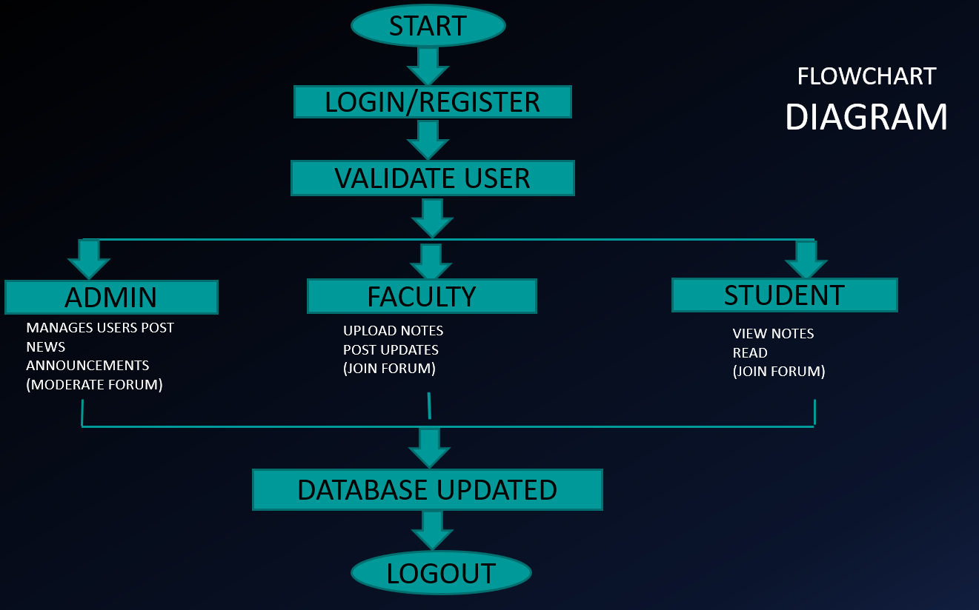

Slide 9




ADVANTAGES :
Centralized communication and updates.
Reduces time and manual work.
Improves transparency and engagement.
Encourages collaborative learning and teamwork.
Secure and restricted access to campus members only.

Slide 10
HTML TAGS USED :
1. `<!DOCTYPE html>`: The document type declaration
2. `<html>`: The root element of the HTML document
3. `<head>`: The head section of the HTML document
4. `<meta>`: Metadata about the document (charset, viewport)
5. `<title>`: The title of the HTML document
6. `<style>`: Styles for the HTML document
7. `<body>`: The body section of the HTML document
8. `<header>`: The header section of the HTML document

Slide 11
9. `<h1>`: A level 1 heading
10. `<nav>`: The navigation section of the HTML document
11. `<ul>`: An unordered list
12. `<li>`: A list item
13. `<a>`: A hyperlink
14. `<main>`: The main content section of the HTML document
15. `<h2>`: A level 2 heading
16. `<p>`: A paragraph
17. `<footer>`: The footer section of the HTML document

Slide 12
HTML ATTRIBUTES USED :
1. `lang="en"`: Specifies the language of the HTML document
2. `charset="UTF-8"`: Specifies the character encoding of the HTML document
3. `name="viewport"`: Specifies the viewport settings for mobile devices
4. `content="width=device-width, initial-scale=1.0"`: Specifies the viewport settings (width and initial scale)
5. `href="#"`: Specifies the hyperlink reference (in this case, a placeholder)
6. `style`: Specifies inline styles for an element (used in the `<style>` block)
7. `class`: Not explicitly used, but could be added to elements for styling or scripting purposes

Slide 13
CONCLUSION:
The Students’ Intranet Website successfully bridges the communication gap between students and faculty, creating a connected and informed campus environment. It serves as a reliable digital communication hub, promoting collaboration, faster updates, and academic interaction within the institution.
This project demonstrates the application of web technologies to design a practical, secure, and efficient intranet system that enhances both learning and communication experiences.

Slide 14
THANKYOU

